Slide 1
PICTIONAY ENGLISH
Apprentice : ROINER ESTIBER GOMEZ PANESSO
FICHA 1193362-G2
ADSI-FDS

Slide 2
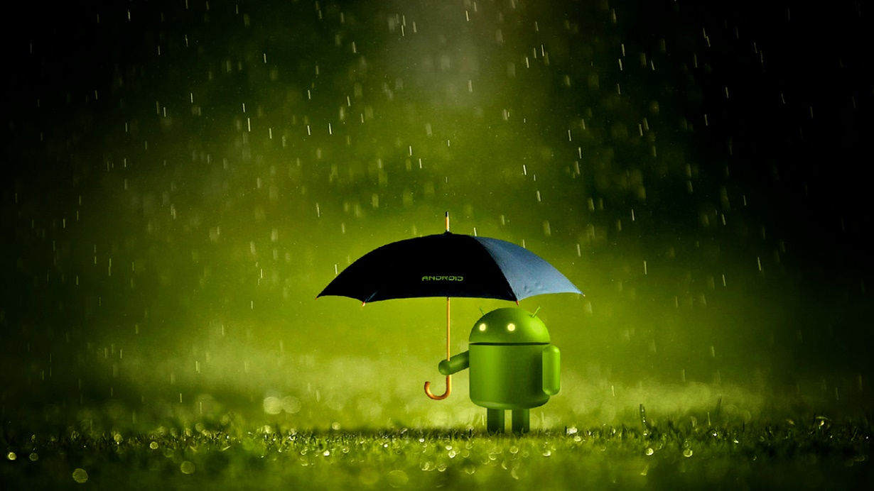
ANDROID
It is an initially designed for Cell Phones, like IOS operating system, Symbian and Blackberry operating system. What makes it different is that it is based on Linux, the free operating core UN system, free and multiplatform.

Slide 3
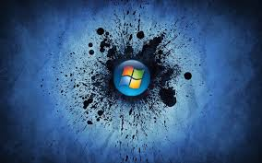
MICROSOFT WINDOWS
Microsoft Windows is an operating system is feasible, the UN set of programs that enable the management of computer resources. This type of system begins to work when the team to manage the hardware starting from the most basic levels lights up.

Slide 4

LINUX
Linux is an operating system, a great piece of software that controls a computer. It is similar to Microsoft Windows, but completely free. The correct name is GNU / Linux but "Linux" is used more.

Slide 5
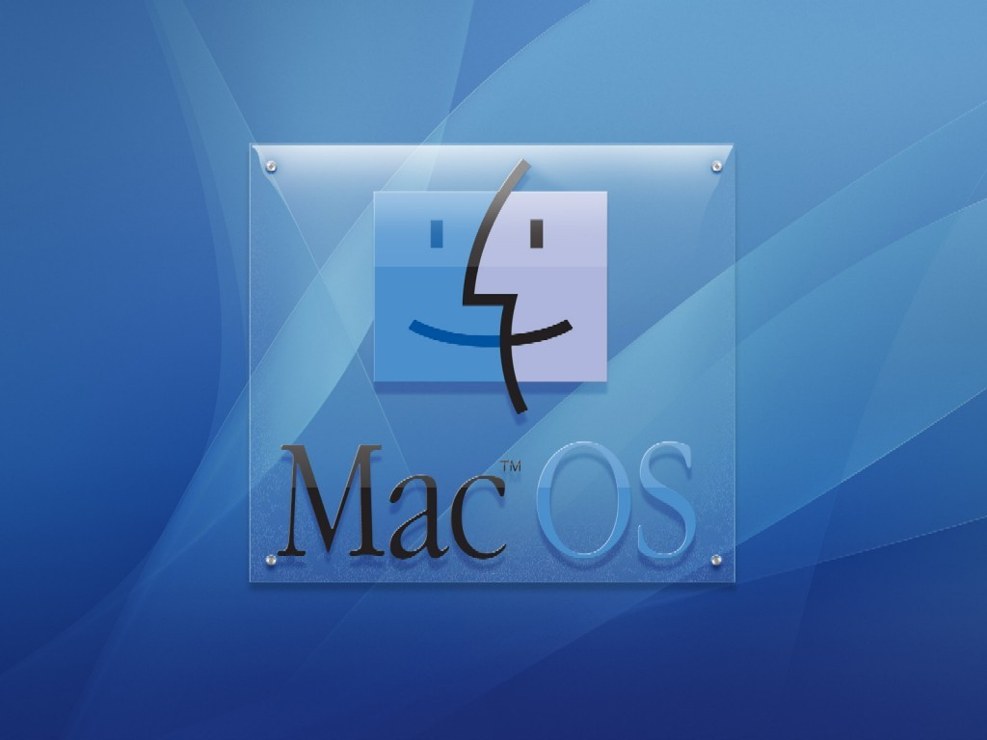
MAC OS
Operating system created by Apple for its Macintosh line of computers, also applied retroactively versions prior to System 7.6, and first appeared on System 7.5.1. It is known for being one of the first systems aimed at the general public in having a graphical interface composed mouse interaction with window, icons and menus.

Slide 6

UNIX
It is a portable multitasking, multiuser operating system; developed in principle in 1969 by a group of employees at Bell Laboratories of AT & T, including Dennis Ritchie, Ken Thompson and Douglas McIlroy.

Slide 7

SYMBIAN
Symbian was owned by Nokia operating system, which in the past was the result of the alliance of several mobile phone companies including Nokia were, Sony Mobile Communications, Psion, Samsung, Siemens, Arima, Benq, Fujitsu, Lenovo, LG, Motorola , Mitsubishi Electric, Panasonic, Sharp, etc.

Slide 8

SOLARIS
Solaris is a UNIX -type operating system originally developed in 1992 by Sun Microsystems and now owned by Oracle Corporation after the acquisition of Sun by this. SunOS successor is a certified officially as system version of UNIX. It runs on x86 and SPARC architectures for servers and workstations.

Slide 9

REDHAT
Red Hat is famous worldwide for the various efforts to support the free software movement. Not only they work on the development of one of the most popular Linux distributions, but also in marketing different products and services based on open source software services.

Slide 10
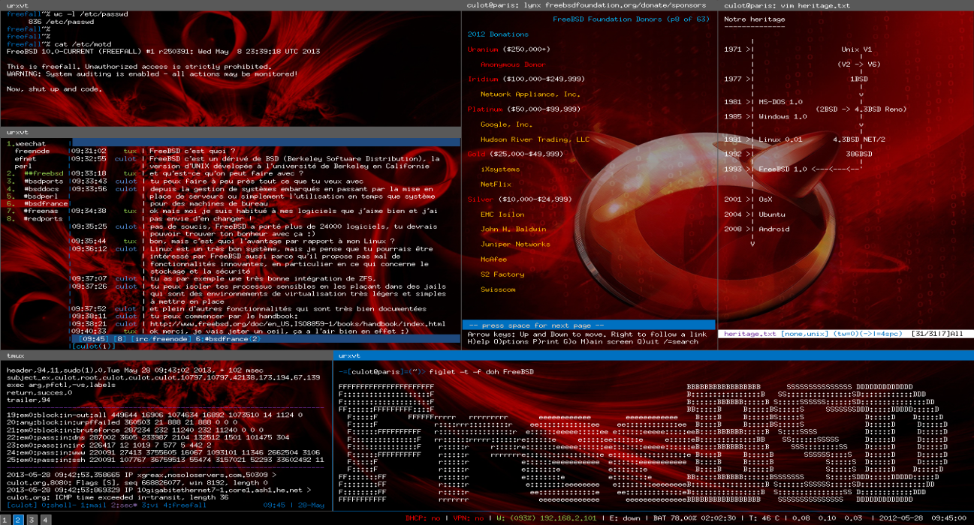
FREEBDS
It is an advanced operating system for x86 compatible architectures amd64 compatible FreeBSD is derived from BSD

Slide 11

BLACK BERRY.
It is a brand of smart phones developed by the Canadian company BlackBerry, which integrates mobile email service since 1999; but it includes typical smartphone applications: address book, address book, calendar, task list, notepad, and browser.

Slide 12
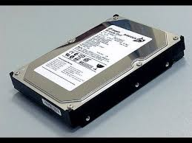
DISCO DURO (hard disk)
The hard drive is the system devices which use PC memory to store all programs and files because it is the only one capable of storing data even if it is not powered by electric current. This is what differentiates it from other memories from your computer, such as RAM, which is used to run programs as these lose information in the event of power failure.

Slide 13
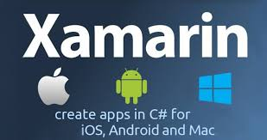
XAMARIN
Xamarin is a tool for developers of mobile applications, and the novelty of this tool is the ability for the developer to write your app in C # language and the same code is translated to run on iOS, Android and Windows Phone.

Slide 14

DROPBOX
Dropbox is the UN Hosting Service multiplatform files in the cloud, operated by the company Dropbox. The service allows users to store and sync files online and between computers and share files and folders with other users and with Tablets and Phones.

Slide 15
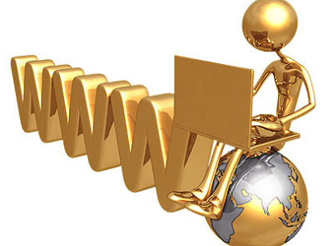
WWW.
Contraction of Expression World Wide Web, "Red global computer ', logical access and search System Information available in internet, Whose child information units web pages.

Slide 16

SONY
Commonly referred to as Sony, it is a Japanese multinational company based in Tokyo (Japan) and one of the leading manufacturers worldwide in consumer electronics: audio and video, computer, photography, video, mobile and professional products.

Slide 17

ONEDRIVE
One Drive is cloud Microsoft that lets you save your files or documents online and access them from anywhere or computer with Internet connection.

Slide 18

DEVELOPER
The developer (also known as an analyst / programmer) to design and develop an application for computers, i.e. to transcribe a need in a software solution written in computer language.

Slide 19
ACTIVISION
Activision is an American video game company. It was the first independent developer and distributor of this type of games, founded on October 1, 1979. Its first products were cartridges for the Atari 2600 game console, and today is the third largest distributor of video games.

Slide 20
ASHAMPOO
A shampoo Burning Studio is a program recording optical discs such as CDs, DVDs and Blu - ray. Version 6 is distributed free, while 8 are commercial. notable for having menu orderly and easy to use options.

Slide 21
HARWARE
hardware is the tangible physical part of a computer system; its electrical, electronic, electromechanical components, mecánicos.1 Cables, cabinets or boxes, peripherals of all kinds and any other physical element involved make up the hardware; contrary, logical and intangible support is called software.

Slide 22
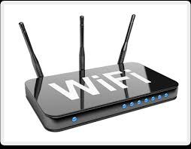
ROUTER
A router also known as a router or packet router is a device that provides connectivity at the network level or third level in the OSI model.

Slide 23
MEMORIA RAM
It is used as working memory computer for the operating system, programs and most of the software. In RAM ALL INSTRUCTIONS running the Central Processing Unit (Processor) and other computer units are loaded.

Slide 24
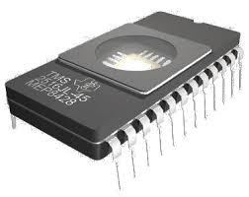
MEMORIA ROM
ROM (read- only memory) or read-only memory is the memory used to store programs that start up the computer and perform diagnostics. Most computers have a small amount of ROM (several thousand bytes).

Slide 25
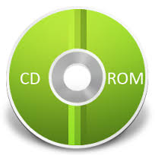
CD ROM
It is a compact disc that uses laser light to store and read large amounts of information in digital format. The CD- ROM standard was established in 1985 by Sony and Philips.

Slide 26
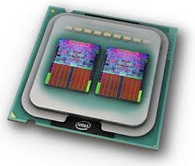
MEMORIA CACHE
The cache is a very fast random access memory auxiliary low capacity, which is added between main memory and the CPU to improve performance of the workstation. In the cache, the system saves main memory positions most frequently expected will be used, gaining much speed access to them.

Slide 27

COOKIES
A cookie, computer cookie or cookie is small information sent by a website and stored in the user's browser so that the website can consult the previous user activity.

Slide 28

OPERA
Opera is a web browser developed by the Norwegian company Opera Software. Use the rendering engine Blink.1 has versions for desktop computers, mobile phones and tablets. Supported operating systems are Microsoft desktop Opera Windows , Mac OS X and GNU / Linux (Ubuntu 64 - bit) .2 mobile operating systems are supported, BlackBerry , Symbian , Windows Mobile, Windows Phone , Android and iOS ; and the Java ME platform .

Slide 29

SAFARI
Safari is a web browser developed by Apple closed Inc. code is available for OS X iOS (the system used by the iPhone, iPod touch and iPad).

Slide 30
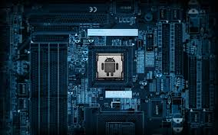
CPU
CPU stands for Central Processing Unit (central processing unit), it is pronounced as separate letters. The CPU is the brain of the computer. Sometimes it is referred to simply as the processor or central processor; the CPU is where most calculations take place. In terms of computing power, the CPU is the most important element of a computer system.

Slide 31
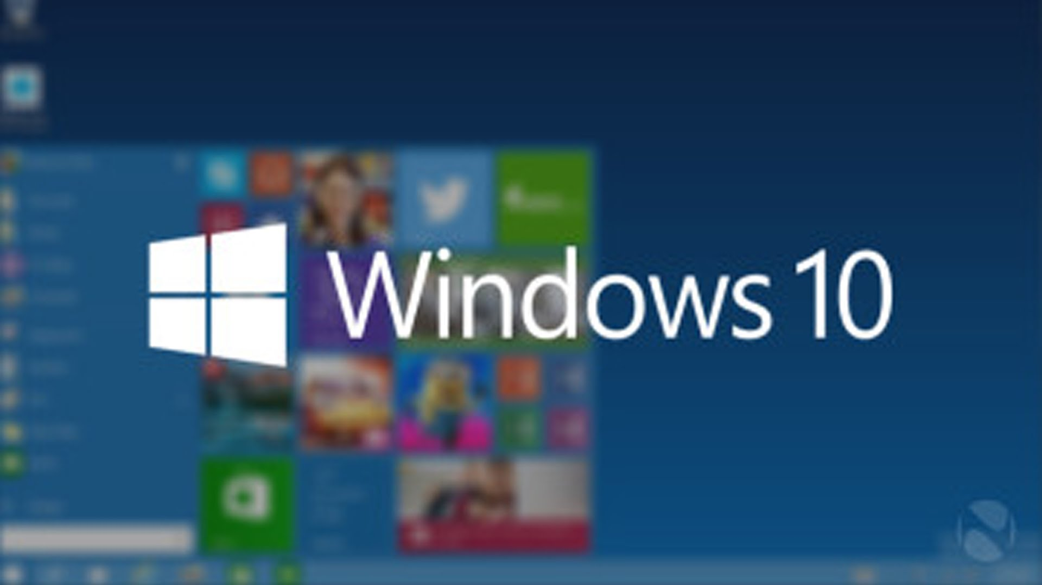
WINDOWS 10
Windows 10 is the new version of the operating system Microsoft , which comes paragraph · try to redeem the errors Windows 8, and make the experience of USO much better known and traditional user keyboard and mouse , bringing back several features many homesick , and incorporating new .

Slide 32
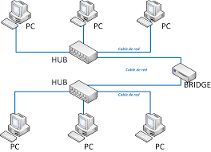
BRIDGE
Interconnects networks and provides a way of communication between various segments of subnets

Slide 33
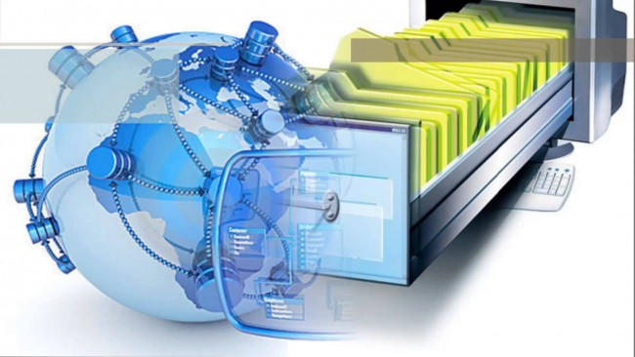
BASE DE DATOS
A database or database is a set of data belonging to the same context and systematically stored for later use . In this sense; a library can be considered a database composed mostly of documents and texts printed on paper and indexed for reference. Currently, due to technological development in fields such as computer and electronics, most databases are in digital format , this being an electronic component therefore has developed and offers a wide range of solutions to the problem of data storage.

Slide 34
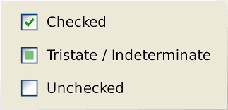

CHECKBOX
It is an element that is part of the user interface of an applet or application ,
and which has two states : on and off . Preferably this object type is used to
specify options or preferences , rather than to provoke actions with activation.
It is a class of AWT package with its constructors, methods and variables.

Slide 35
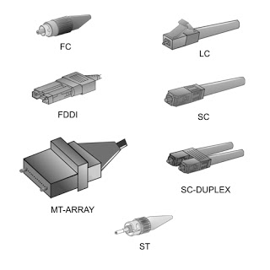
CONNECTORS
Connectors are words or groups of words used to link ideas clearly expressing how they relate to each other . Good use of connectors gives greater coherence to our discourse and makes it more intelligible to the receiver.

Slide 36

SOFTWARE
It is known as the logical computer software or software of a computer system, comprising all the necessary software components that enable specific tasks, as opposed to the physical components that are called hardware.

Slide 37

ENTROPY
CORRESPONDS TO THE THIRD LAW OF THE STATE TERMODINAMICA ES MORE LIKELY, DISORDER, CHAOS, RANDOMNESS, IN WHICH THE SYSTEM LOSES ITS ABILITY TO PROCESS AND COLLECT ENERGY

Slide 38

GESTALT
is one It systemic feature as a result of which that affects a part of the system, it has an impact on the whole.

Slide 39
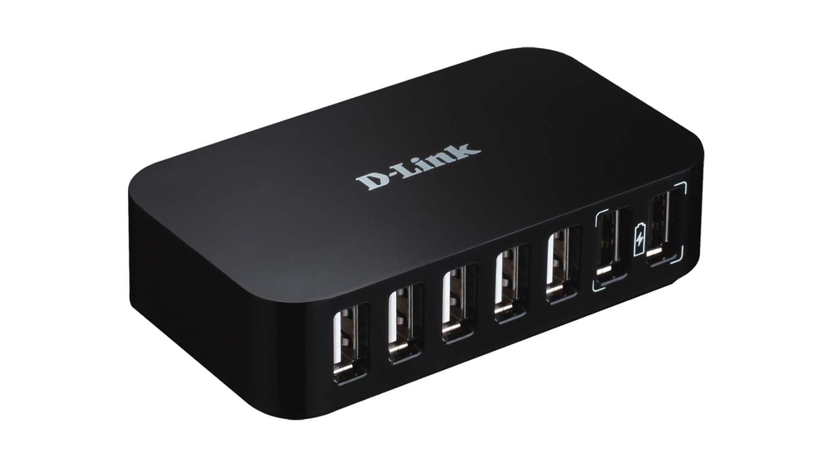
HUB
Reinforces the signal cables and allows you to set forms of bus, ring or other in the communication network.

Slide 40
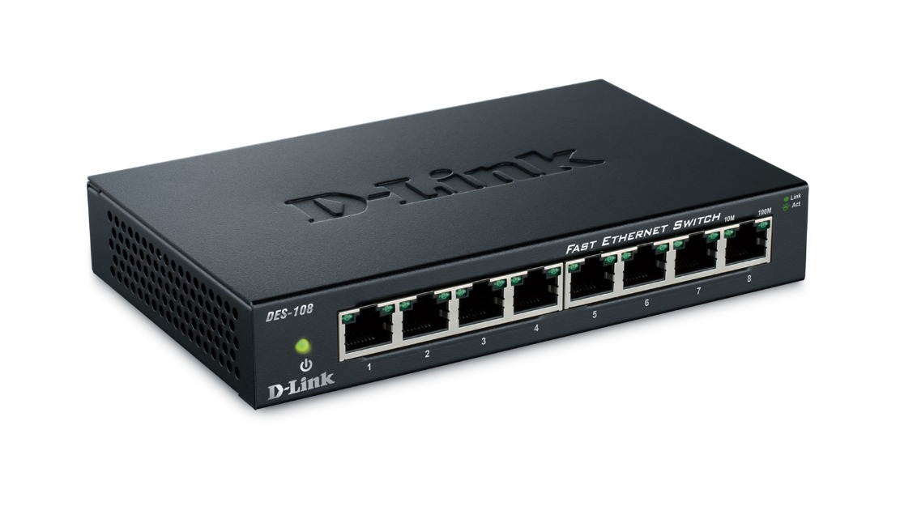
SWITCH
In charge of interconnect two or more network segments, similar to the bridges of networks

Slide 41
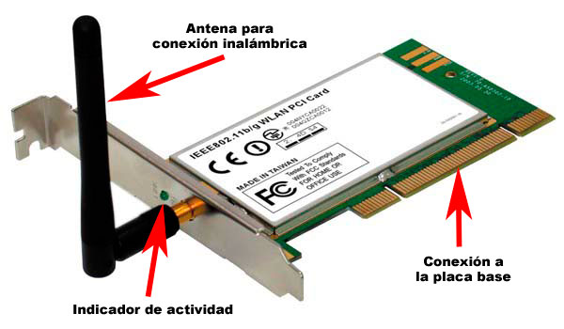
NETWORK CARD
Connect the computer with the medium of transmission network, either wired or wirelessly

